Slide 1
Java Collections
Professor Evan Korth
(adapted from Sun’s collections documentation)

Slide 2
Java Collections Framework
The Java language API provides many of the data structures from this class for you.
It defines a “collection” as “an object that represents a group of objects”.
It defines a collections framework as “a unified architecture for representing and manipulating collections, allowing them to be manipulated independent of the details of their representation.”

Slide 3
Collections Framework (cont)
Collection Interfaces - Represent different types of collections, such as sets, lists and maps. These interfaces form the basis of the framework.
General-purpose Implementations - Primary implementations of the collection interfaces.
Legacy Implementations - The collection classes from earlier releases, Vector and Hashtable, have been retrofitted to implement the collection interfaces.
Wrapper Implementations - Add functionality, such as synchronization, to other implementations.
Convenience Implementations - High-performance "mini-implementations" of the collection interfaces.
Abstract Implementations - Partial implementations of the collection interfaces to facilitate custom implementations.
Algorithms - Static methods that perform useful functions on collections, such as sorting a list.
Infrastructure - Interfaces that provide essential support for the collection interfaces.
Array Utilities - Utility functions for arrays of primitives and reference objects. Not, strictly speaking, a part of the Collections Framework, this functionality is being added to the Java platform at the same time and relies on some of the same infrastructure.

Slide 4
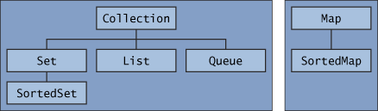
Collection interfaces
The core collection interfaces encapsulate different types of collections. They represent the abstract data types that are part of the collections framework. They are interfaces so they do not provide an implementation!

Slide 5
public interface Collection<E> extends Iterable<E>
Collection — the root of the collection hierarchy. A collection represents a group of objects known as its elements. The Collection interface is the least common denominator that all collections implement and is used to pass collections around and to manipulate them when maximum generality is desired. Some types of collections allow duplicate elements, and others do not. Some are ordered and others are unordered. The Java platform doesn't provide any direct implementations of this interface but provides implementations of more specific subinterfaces, such as Set and List.

Slide 6
public interface Collection<E> extends Iterable<E>
public interface Collection<E> extends Iterable<E> {
// Basic operations
int size();
boolean isEmpty();
boolean contains(Object element);
boolean add(E element); //optional
boolean remove(Object element); //optional
Iterator<E> iterator();
// Bulk operations
boolean containsAll(Collection<?> c);
boolean addAll(Collection<? extends E> c); //optional
boolean removeAll(Collection<?> c); //optional
boolean retainAll(Collection<?> c); //optional
void clear(); //optional
// Array operations
Object[] toArray();
<T> T[] toArray(T[] a);
}

Slide 7
A note on iterators
An Iterator is an object that enables you to traverse through a collection and to remove elements from the collection selectively, if desired. You get an Iterator for a collection by calling its iterator() method. The following is the Iterator interface.
public interface Iterator<E> {
boolean hasNext();
E next();
void remove(); //optional
}

Slide 8
public interface Set<E> extends Collection<E>
Set — a collection that cannot contain duplicate elements. This interface models the mathematical set abstraction and is used to represent sets, such as the cards comprising a poker hand, the courses making up a student's schedule, or the processes running on a machine.

Slide 9
public interface Set<E> extends Collection<E>
public interface Set<E> extends Collection<E> {
// Basic operations
int size();
boolean isEmpty();
boolean contains(Object element);
boolean add(E element); //optional
boolean remove(Object element); //optional
Iterator<E> iterator();
// Bulk operations
boolean containsAll(Collection<?> c);
boolean addAll(Collection<? extends E> c); //optional
boolean removeAll(Collection<?> c); //optional
boolean retainAll(Collection<?> c); //optional
void clear(); //optional
// Array Operations
Object[] toArray();
<T> T[] toArray(T[] a);
}
Note: nothing added to Collection interface – except no duplicates allowed

Slide 10
public interface List<E> extends Collection<E>
List — an ordered collection (sometimes called a sequence). Lists can contain duplicate elements. The user of a List generally has precise control over where in the list each element is inserted and can access elements by their integer index (position). If you've used Vector, you're familiar with the general flavor of List.

Slide 11
public interface List<E> extends Collection<E>
public interface List<E> extends Collection<E> {
// Positional access
E get(int index);
E set(int index, E element); //optional
boolean add(E element); //optional
void add(int index, E element); //optional
E remove(int index); //optional
boolean addAll(int index,
Collection<? extends E> c); //optional
// Search
int indexOf(Object o);
int lastIndexOf(Object o);
// Iteration
ListIterator<E> listIterator();
ListIterator<E> listIterator(int index);
// Range-view
List<E> subList(int from, int to);
}

Slide 12

A note on ListIterators
The three methods that ListIterator inherits from Iterator (hasNext, next, and remove) do exactly the same thing in both interfaces. The hasPrevious and the previous operations are exact analogues of hasNext and next. The former operations refer to the element before the (implicit) cursor, whereas the latter refer to the element after the cursor. The previous operation moves the cursor backward, whereas next moves it forward.
The nextIndex method returns the index of the element that would be returned by a subsequent call to next, and previousIndex returns the index of the element that would be returned by a subsequent call to previous
The set method overwrites the last element returned by next or previous with the specified element.
The add method inserts a new element into the list immediately before the current cursor position.
public interface ListIterator<E> extends Iterator<E> {
boolean hasNext();
E next();
boolean hasPrevious();
E previous();
int nextIndex();
int previousIndex();
void remove(); //optional
void set(E e); //optional
void add(E e); //optional
}

Slide 13
public interface Queue<E> extends Collection<E>
Queue — a collection used to hold multiple elements prior to processing. Besides basic Collection operations, a Queue provides additional insertion, extraction, and inspection operations.

Slide 14
public interface Queue<E> extends Collection<E>
public interface Queue<E> extends Collection<E> {
E element(); //throws
E peek(); //null
boolean offer(E e); //add - bool
E remove(); //throws
E poll(); //null
}

Slide 15
public interface Map<K,V>
Map — an object that maps keys to values. A Map cannot contain duplicate keys; each key can map to at most one value. If you've used Hashtable, you're already familiar with the basics of Map.

Slide 16
public interface Map<K,V>
public interface Map<K,V> {
// Basic operations
V put(K key, V value);
V get(Object key);
V remove(Object key);
boolean containsKey(Object key);
boolean containsValue(Object value);
int size();
boolean isEmpty();
// Bulk operations
void putAll(Map<? extends K, ? extends V> m);
void clear();
// Collection Views
public Set<K> keySet();
public Collection<V> values();
public Set<Map.Entry<K,V>> entrySet();
// Interface for entrySet elements
public interface Entry {
K getKey();
V getValue();
V setValue(V value);
}
}

Slide 17
public interface SortedSet<E> extends Set<E>
SortedSet — a Set that maintains its elements in ascending order. Several additional operations are provided to take advantage of the ordering. Sorted sets are used for naturally ordered sets, such as word lists and membership rolls.

Slide 18
public interface SortedSet<E> extends Set<E>
public interface SortedSet<E> extends Set<E> {
// Range-view
SortedSet<E> subSet(E fromElement, E toElement);
SortedSet<E> headSet(E toElement);
SortedSet<E> tailSet(E fromElement);
// Endpoints
E first();
E last();
// Comparator access
Comparator<? super E> comparator();
}

Slide 19
Note on Comparator interface
Comparator is another interface (in addition to Comparable) provided by the Java API which can be used to order objects.
You can use this interface to define an order that is different from the Comparable (natural) order.

Slide 20
public interface SortedMap<K,V> extends Map<K,V>
SortedMap — a Map that maintains its mappings in ascending key order. This is the Map analog of SortedSet. Sorted maps are used for naturally ordered collections of key/value pairs, such as dictionaries and telephone directories.

Slide 21
public interface SortedMap<K,V> extends Map<K,V>
public interface SortedMap<K, V> extends Map<K, V>{
SortedMap<K, V> subMap(K fromKey, K toKey);
SortedMap<K, V> headMap(K toKey);
SortedMap<K, V> tailMap(K fromKey);
K firstKey();
K lastKey();
Comparator<? super K> comparator();
}

Slide 22
General-purpose Implementations
Interfaces | Implementations
 | Hash table | Resizable array | Tree (sorted) | Linked list | Hash table + Linked list
Set | HashSet |  | TreeSet (sorted) |  | LinkedHashSet
List |  | ArrayList |  | LinkedList
Queue
Map | HashMap |  | TreeMap (sorted) |  | LinkedHashMap
Note the naming convention
LinkedList also implements queue and there is a PriorityQueue implementation (implemented with heap)

Slide 23
implementations
Each of the implementations offers the strengths and weaknesses of the underlying data structure.
What does that mean for:
  Hashtable
  Resizable array
  Tree
  LinkedList
  Hashtable plus LinkedList
Think about these tradeoffs when selecting the implementation!

Slide 24
Choosing the datatype
When you declare a Set, List or Map, you should use Set, List or Map interface as the datatype instead of the implementing class. That will allow you to change the implementation by changing a single line of code!
-----------------------------------------------------------------------------------------
import java.util.*;
public class Test {
public static void main(String[] args) {
Set<String> ss = new LinkedHashSet<String>();
for (int i = 0; i < args.length; i++)
ss.add(args[i]);
Iterator i = ss.iterator();
while (i.hasNext())
System.out.println(i.next());
}
}

Slide 25
import java.util.*;
public class Test {
public static void main(String[] args)
{
//map to hold student grades
Map<String, Integer> theMap = new HashMap<String, Integer>();
theMap.put("Korth, Evan", 100);
theMap.put("Plant, Robert", 90);
theMap.put("Coyne, Wayne", 92);
theMap.put("Franti, Michael", 98);
theMap.put("Lennon, John", 88);
System.out.println(theMap);
System.out.println("--------------------------------------");
System.out.println(theMap.get("Korth, Evan"));
System.out.println(theMap.get("Franti, Michael"));
}
}

Slide 26
Other implementations in the API
Wrapper implementations delegate all their real work to a specified collection but add (or remove) extra functionality on top of what the collection offers.
  Synchronization Wrappers
  Unmodifiable Wrappers
Convenience implementations are mini-implementations that can be more convenient and more efficient than general-purpose implementations when you don't need their full power
  List View of an Array
  Immutable Multiple-Copy List
  Immutable Singleton Set
  Empty Set, List, and Map Constants

Slide 27
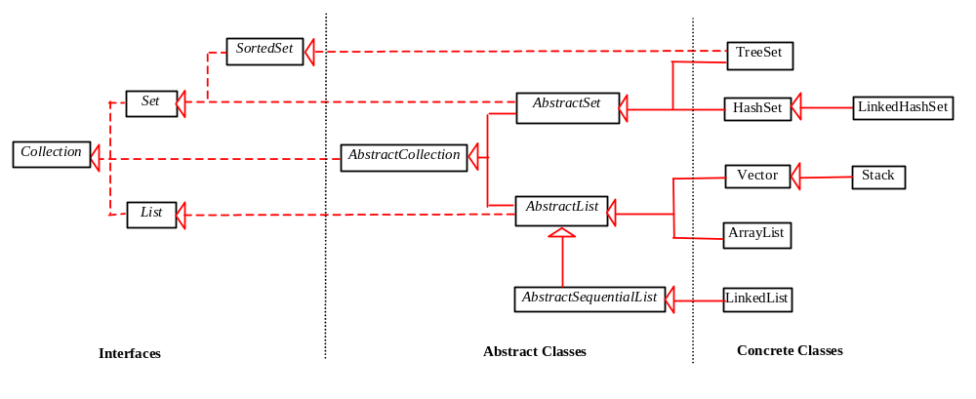
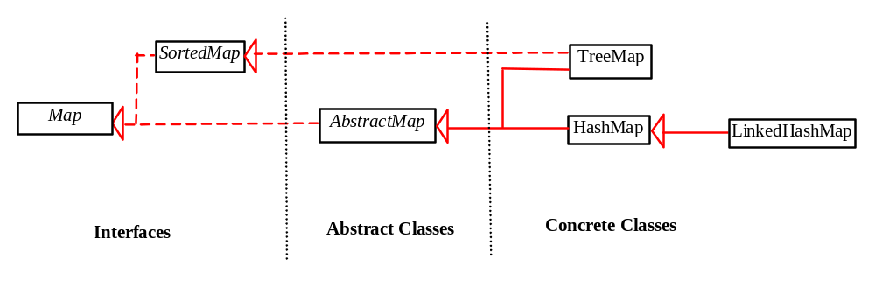
Copyright: Liang

Slide 28
Making your own implementations
Most of the time you can use the implementations provided for you in the Java API.
In case the existing implementations do not satisfy your needs, you can write your own by extending the abstract classes provided in the collections framework.

Slide 29
algorithms
The collections framework also provides polymorphic versions of algorithms you can run on collections.
  Sorting
  Shuffling
  Routine Data Manipulation
    Reverse
    Fill copy
    etc.
  Searching
    Binary Search
  Composition
    Frequency
    Disjoint
  Finding extreme values
    Min
    Max

